Slide 1
Remote Sensing in Urban - Geospatial Analysis and Mapping

Slide 2
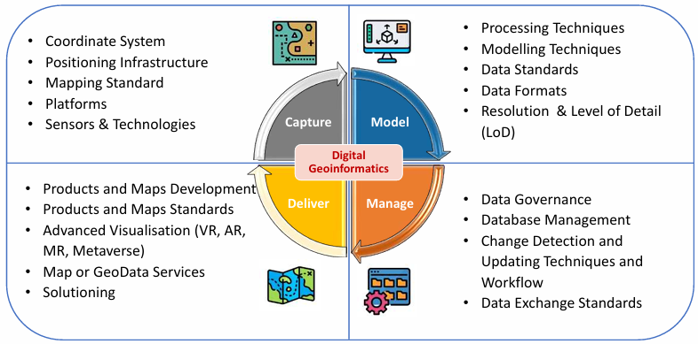
Geospatial Process

Slide 3
What is Geographic Information Systems (GIS)
GIS Integration of relevant Spatial Data
Establish on the foundation of Geographic Database
Enable to extract, edit, update, data saving, enquiry, process, analysis and display

Slide 4
Primary Geographic Data Capture
Geospatial data
Census
Field Surveying
Remote sensing
Photogrammetry
Global Positioning System
Radar imaging
Lidar
Secondary Geographic Data Capture
Human as sensors (or Crowdsourcing)

Slide 5
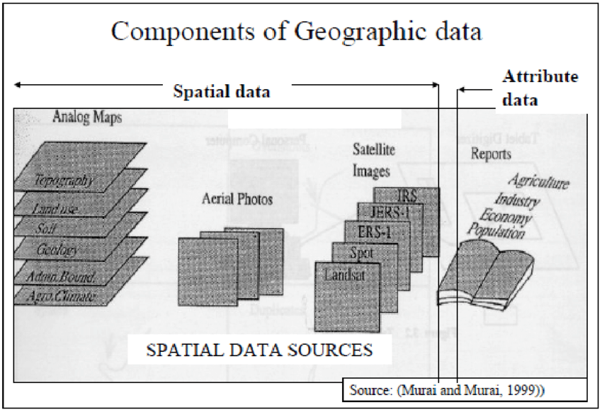
What is Geographic Information Systems (GIS)
GIS is a compute-based system used to capture, store, analyze, manage, and visualize spatial or geographic data
Spatial Data – describing terrain, surface changes, location and spatial relative location by Point, Node, Line, Arc, Polyline, Polygon, Area, Region, Surface, 3D…
Attribute Data – Text and numbers recording geographic elements in either Nominal, ordinal, or Interval-ratio scale.

Slide 6
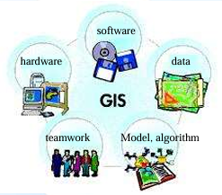
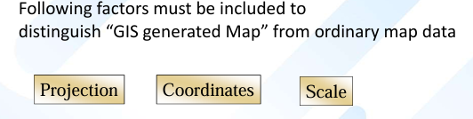
Formation of Geographic Information System
Hardware – Tools for GIS
Software – Operation system for GIS
Data – Shapes, Attribute
Teamwork – emphasizing integration & interoperability
Model, algorithm – System Operation and Rules
General Requirements refer to the functions of GIS
System Requirements refer to the practical requirements of GIS Maps

Slide 7
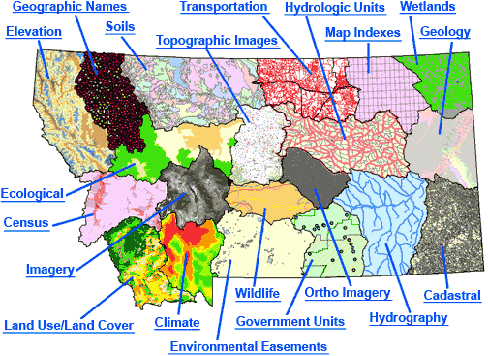
Notes:
Source: http://www.edc.uri.edu/nrs/classes/nrs410/Assignments/DataHandling.htm

Slide 8
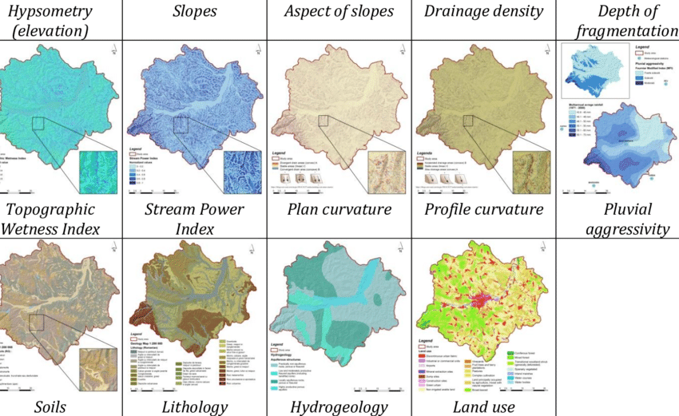
Numerical Factors - Including Control Points, Coordinates, Scales and Map Orientation
Geographic Factors Including Natural, Social and Economical factors such as business, residential area, transportation networks, water systems, terrains, vegetation, borders, etc.
Other Factors
Additional text and tools such as Index, charts, slope scales, diagrams, unit, editing date and other relevant information

Slide 9
Techniques to capture geospatial data
 | Raster | Vector
Primary | Digital remote sensing images | GPS measurements
 | Digital aerial photographs | Survey measurements
Secondary | Scanned maps | Topographic surveys
 | DEMs from maps | Toponymy data sets from atlases
Crowdsourcing | Flickr | Open StreetMap

Slide 10
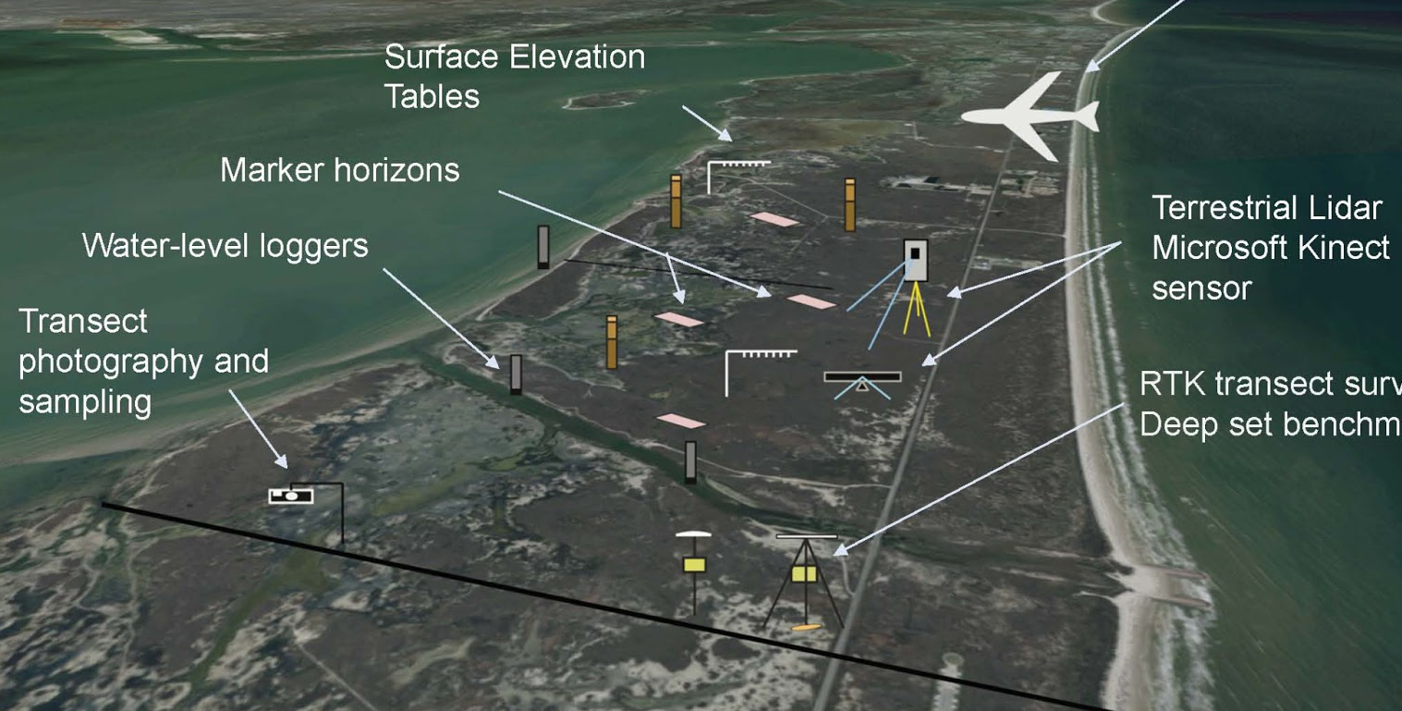

Slide 11
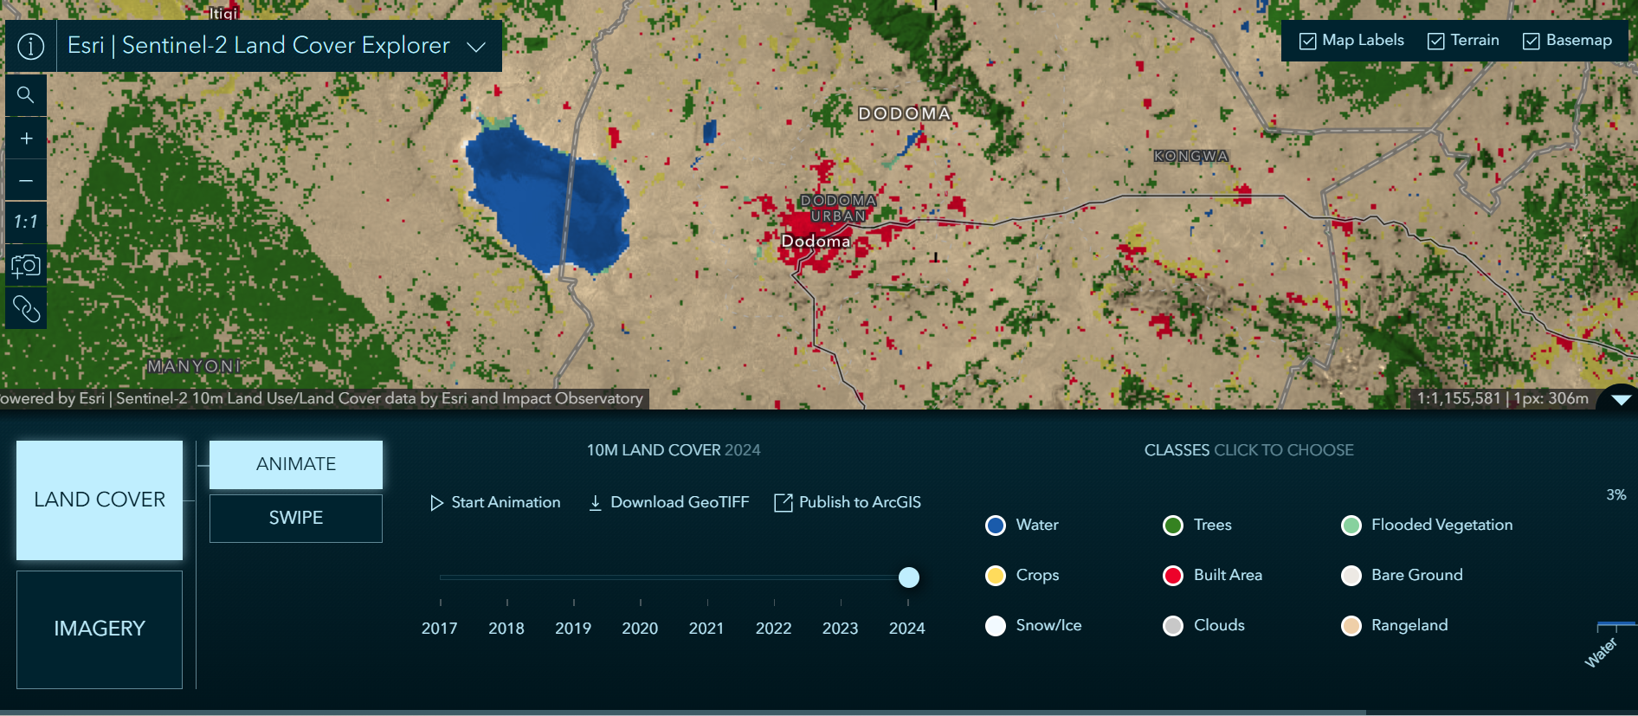
Application – Electronic Maps
https://livingatlas.arcgis.com/landcoverexplorer/#mapCenter=35.74917%2C-6.10338%2C9.00&mode=step&timeExtent=2017%2C2024&renderingRule=4&year=2024

Slide 12
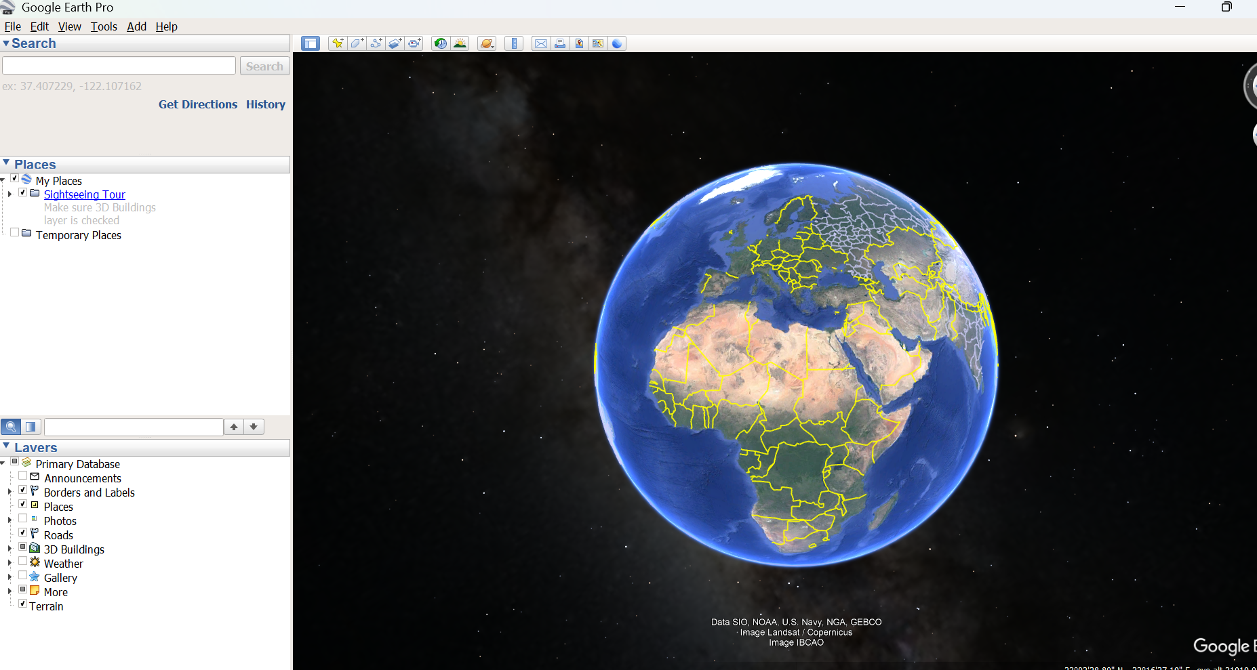
Application – Google Earth

Slide 13
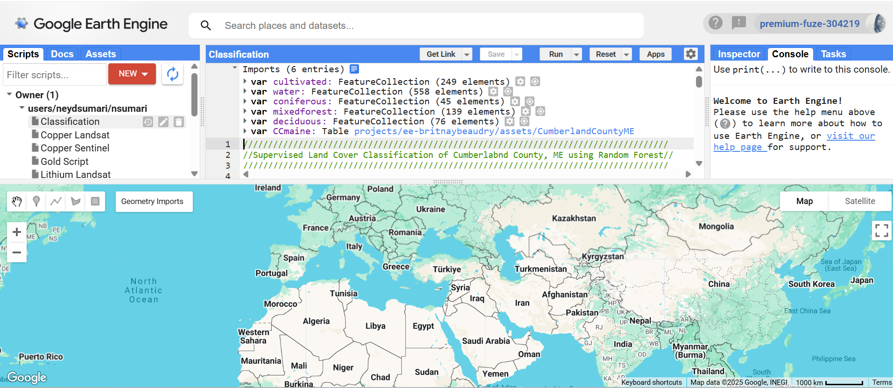
Application – Google Earth Engine
https://livingatlas.arcgis.com/landcoverexplorer/#mapCenter=35.74917%2C-6.10338%2C9.00&mode=step&timeExtent=2017%2C2024&renderingRule=4&year=2024

Slide 14
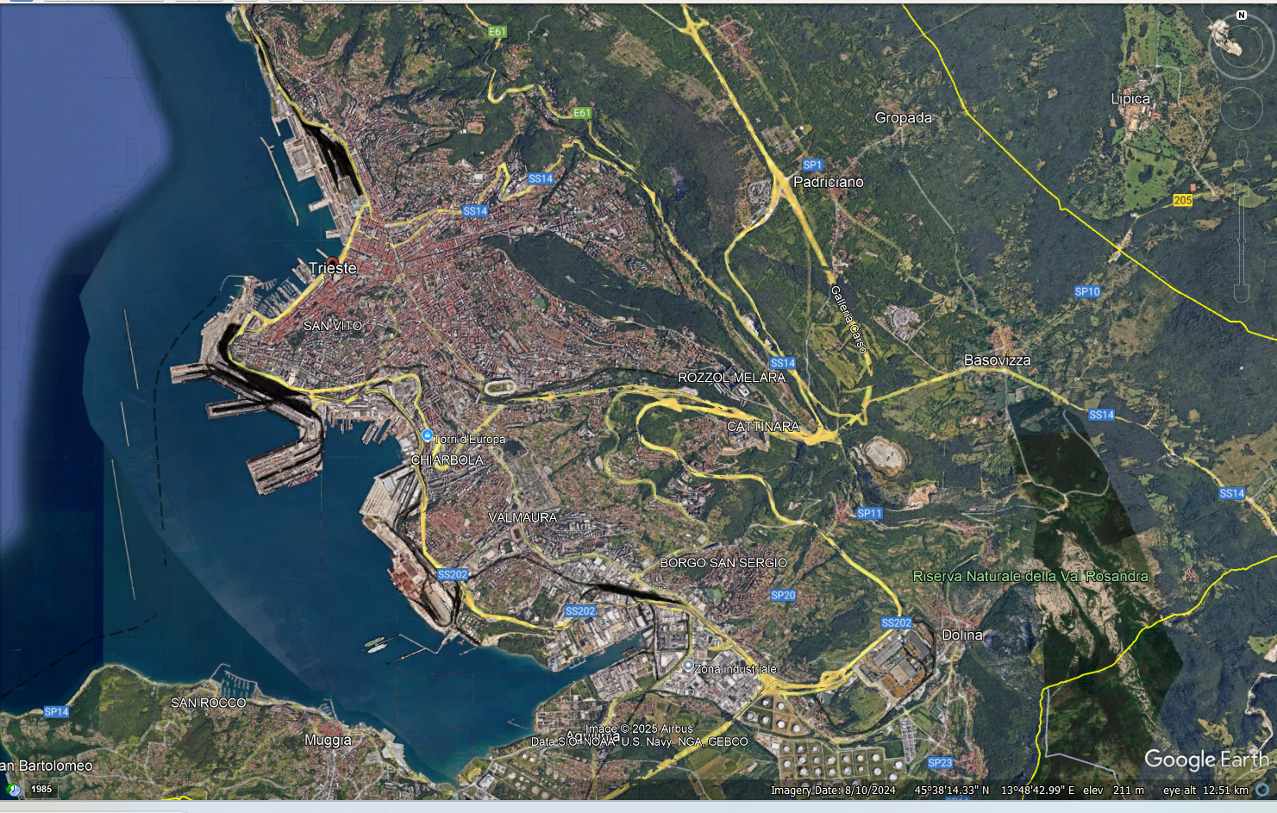
Application – Google Earth

Slide 15
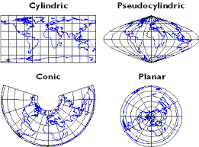
Spatial Information Projections and Coordinates Systems
Projection Type | Preserves | Common Use
Cylindrical | Shape/Direction | Navigation, global maps
Conic | Area/Shape | Regional mapping (e.g., USA)
Azimuthal | Direction/Distance | Polar charts, flight planning
Pseudocylindrical | Compromise | Thematic world maps
Interrupted | Area | Land-focused global maps

Slide 16
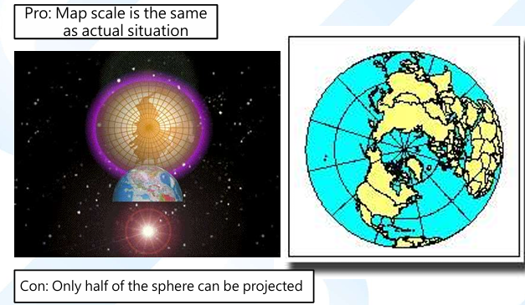
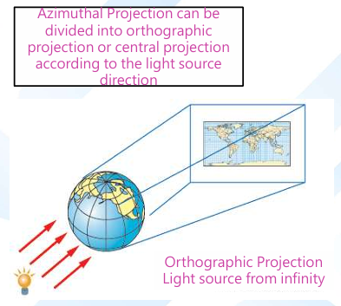
Azimuthal Projection

Slide 17
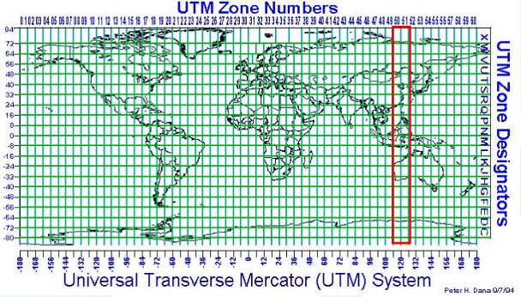
Mercator Projection and Coordination System

Slide 18
Structures of GIS Data

Slide 19
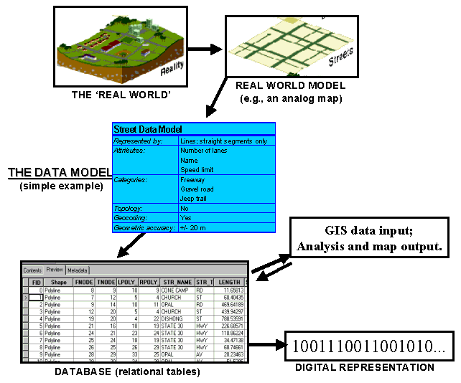
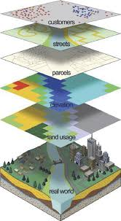
Structures of GIS Data

Slide 20
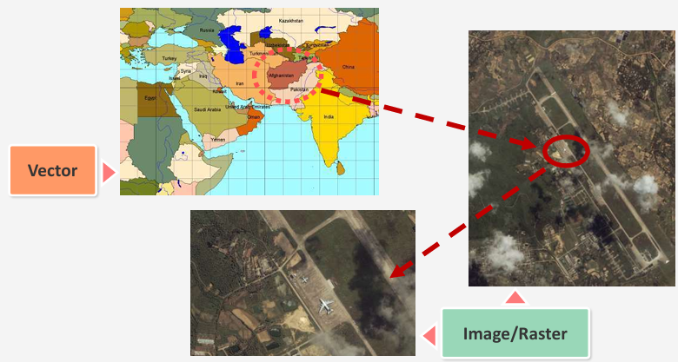
Structures of GIS Data

Slide 21
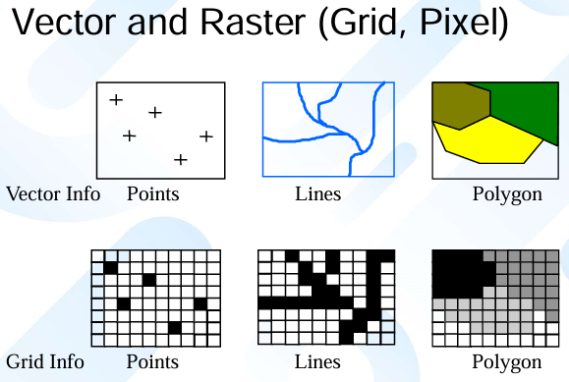

Slide 22
What is Remote Sensing?
Measurement of object characteristics without direct contact

Slide 23
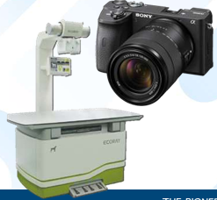

Remote Sensing devices in daily life
General Items: Radio, television, cell phone, GPS receiver, camera, Infrared camera, telescope, etc.
Other optical devices, RF devices, infrared/violet devices, X-ray, Seismograph, radiometer, magnetometer, gravimeter, etc.

Slide 24
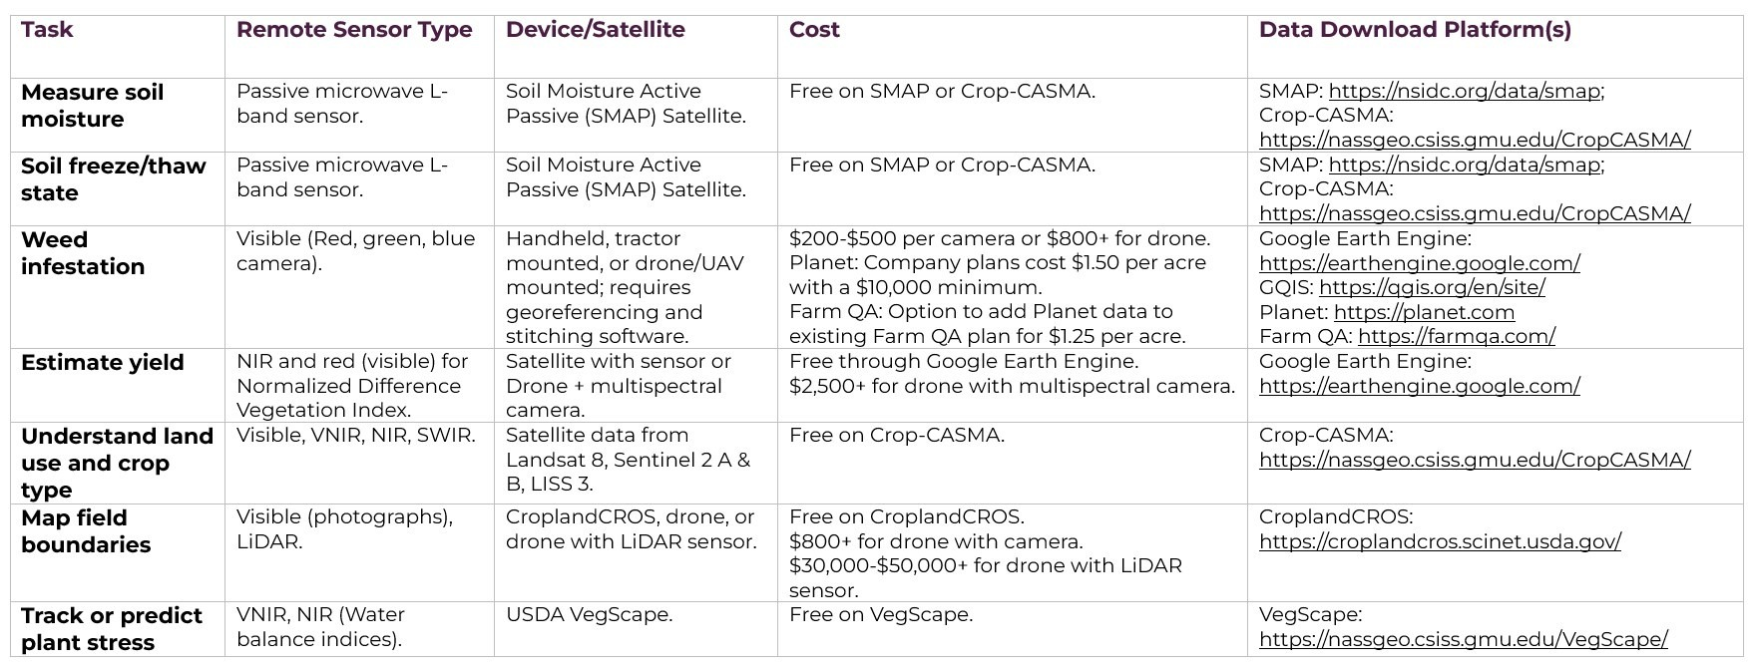
Sensors - Wavelengths
Source: (https://decode6.org/articles/how-do-remote-sensors-work/)

Slide 25
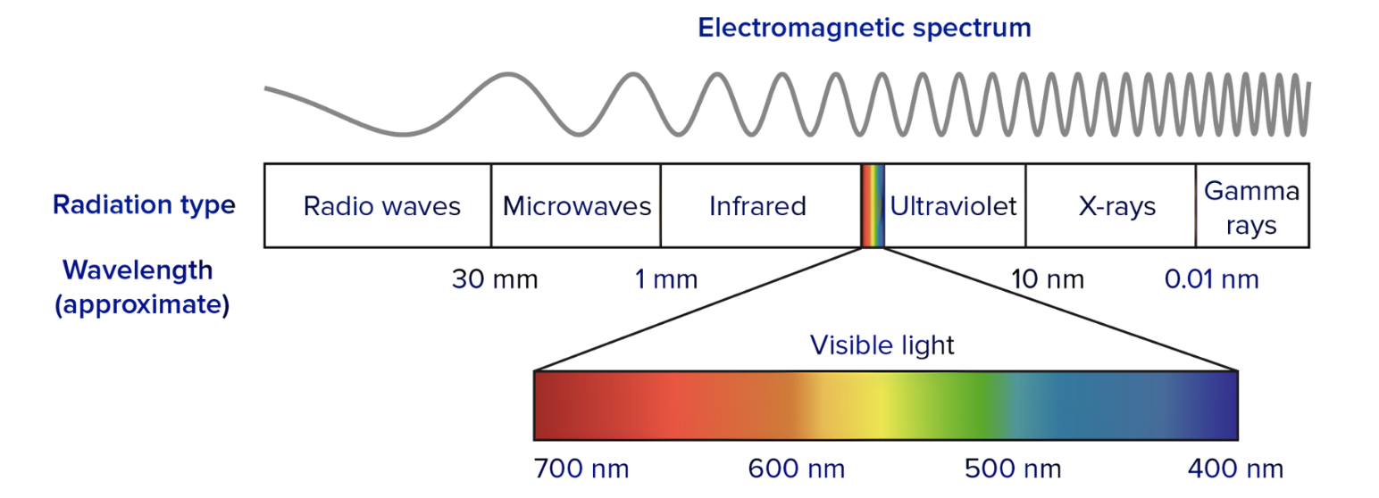
Sensors - Wavelengths
Based on different wavelength, remote sensing can be categorized as the following: Visible-Near Infrared, Infrared, Microwave
Satellite remote sensing for conservation – (WWF_Satellite_Remote_Sensing_Guide_2018) found in the folder

Slide 26
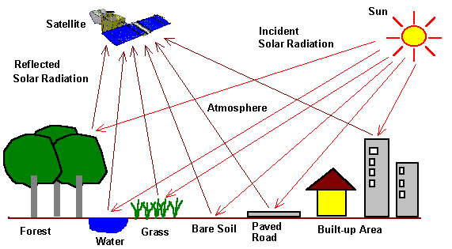
Optical remote sensing
Different materials reflect and absorb differently at different wavelengths. Thus, the targets can be differentiated by their spectral reflectance signatures in the remotely sensed images.

Slide 27
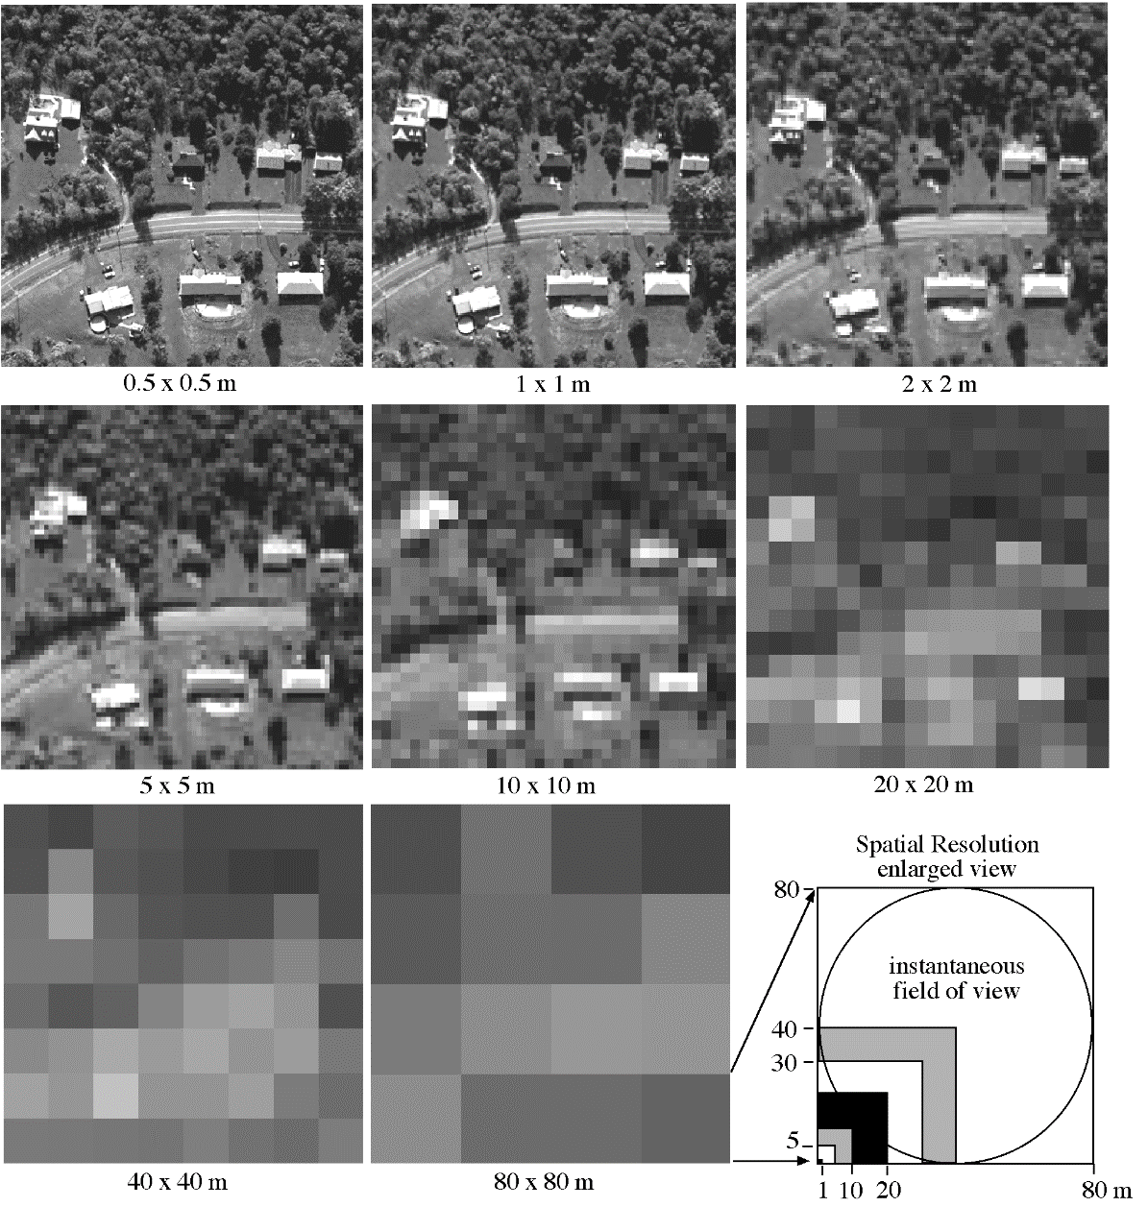
Spatial resolution
Jensen, 2000

Slide 28
Advantages of Remote Sensing
Able to obtain large area information in a relatively short period of time
Information can be displayed in form of graphic and non-graphic messages
Reduce the manpower and risk of operation
Aerial Photos and Satellite Images are the common types of remote sensing images

Slide 29
Remote Sensing
Aerial photo

Slide 30
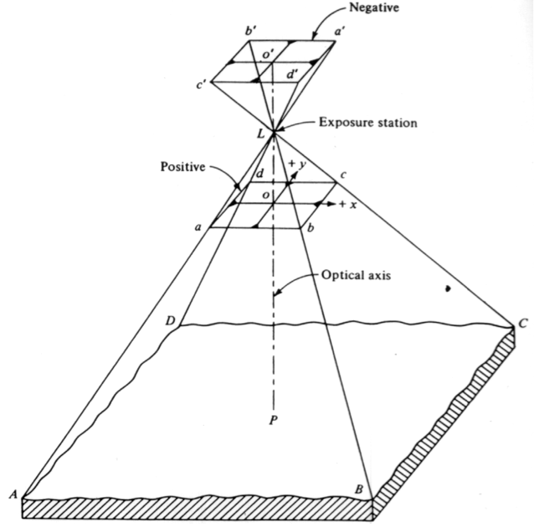
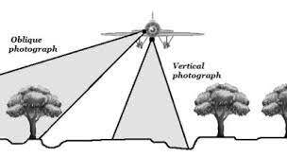
Aerial Photos
Pros
High image quality
High spatial resolution
Large scale images
Cons
Easily affected by weather
Non-real time images

Slide 31
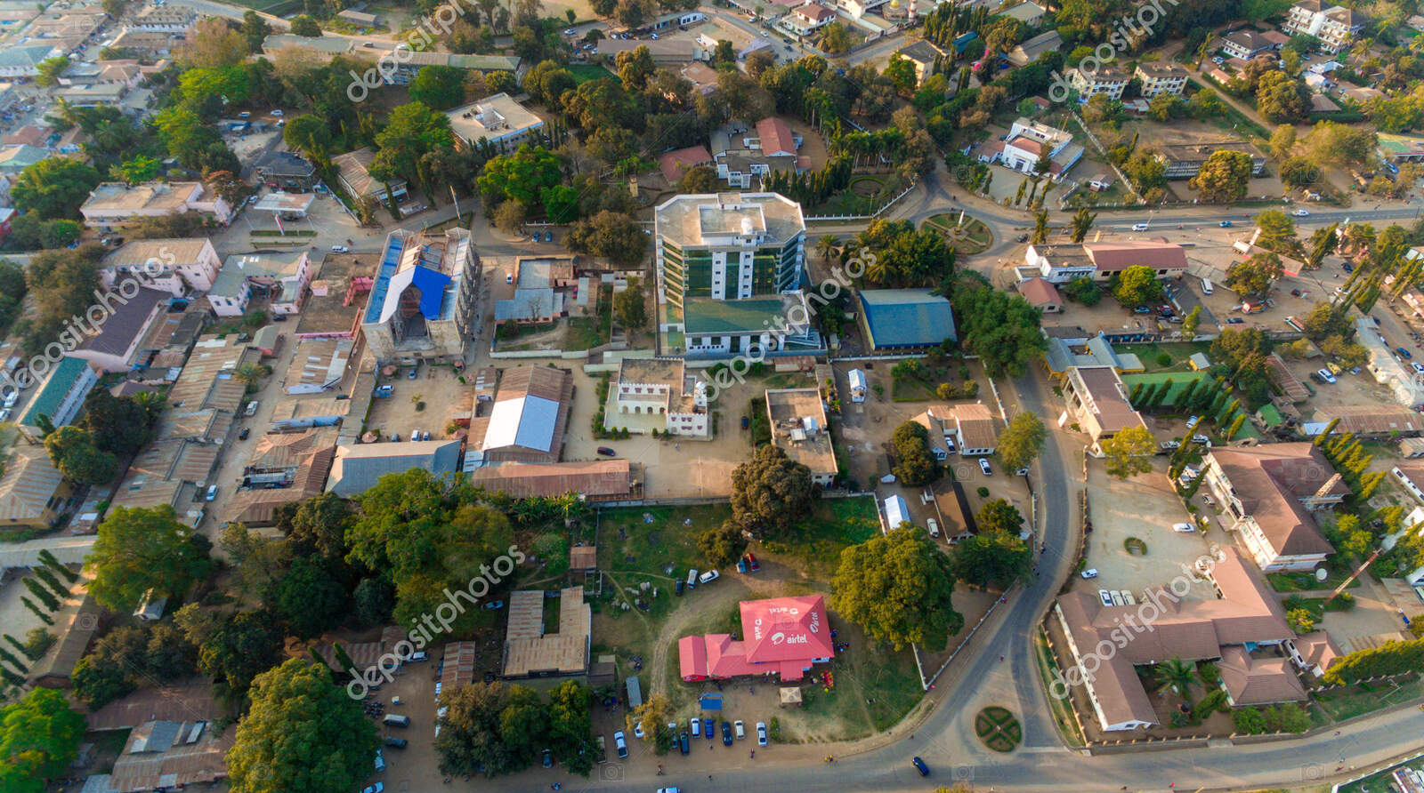

Slide 32
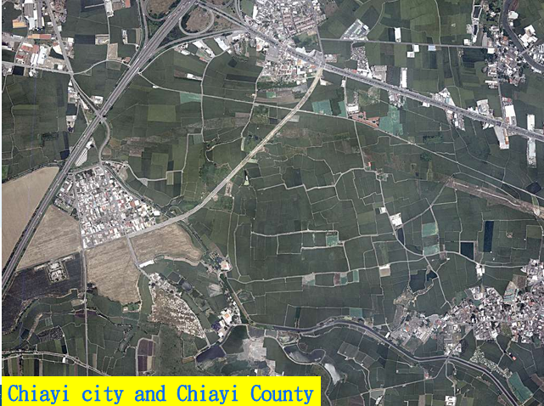

Slide 33
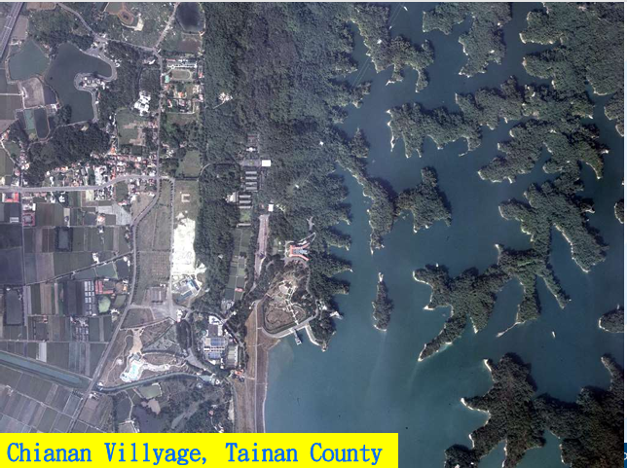

Slide 34
Remote Sensing
Satellite Images

Slide 35
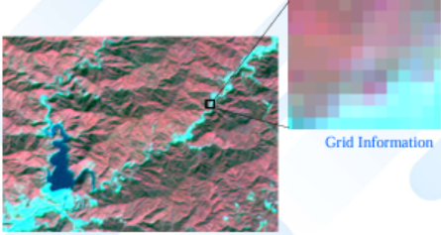
SPOT XS (Band G, R, R)

Slide 36
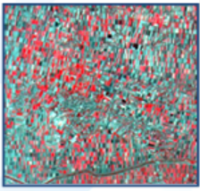
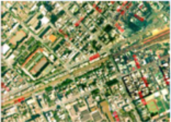
Application of Grid Information – Satellite Images
Satellite Images
Aerial Images

Slide 37
Satellite-Based Land Cover Mapping via Google Earth Engine

Slide 38
What is Google Earth Engine (GEE)?
A cloud-based geospatial processing platform that enables analysis and visualization of satellite imagery and geospatial datasets at a global scale
What does Google Earth Engine provide?
Access to a public data catalog with images from various satellite sensors.
JavaScript & Python APIs for coding and automation.
Built-in machine learning algorithms for classification and modeling.

Slide 39
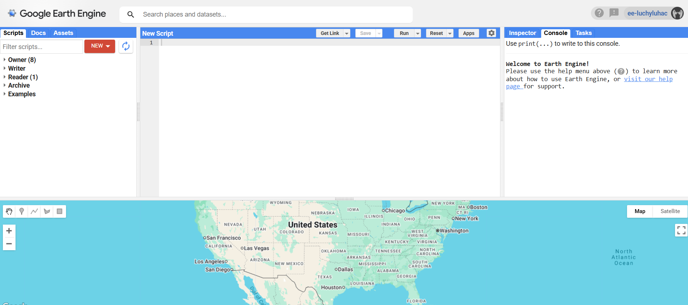
GEE INTERFACE

Slide 40
LAND COVER MAPPING
Step 01 📍Upload Shapefile / Insert Coordinates Step 02 👨‍💻 Create Script
Step 03
Training Data
Step 04 📤 Export and ⬇️ Download Result

Slide 41
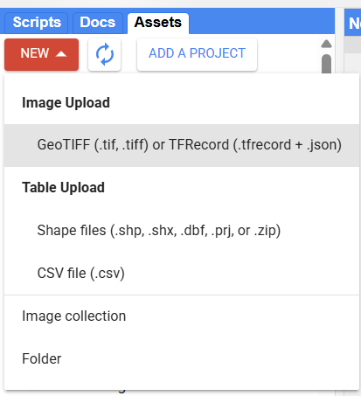
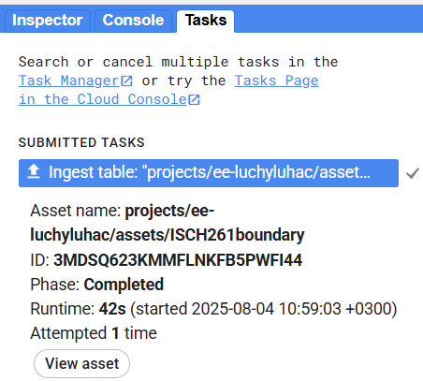
Upload Shapefile/Coordinates
On the left pane, select the Assets tab. Under Table upload, choose: Shape files if you already have the boundary of the area to be classified*.
CSV file if you have a list of corner point coordinates.
*Make sure shape files have all required components (.shp, .shx, .dbf, .prj).
On the right pane, select the Tasks tab and wait for your uploaded file to appear. This confirms that the upload was successful and ready for use.
Once verified return to the assets tab and you should find the file on your assets list

Slide 42
LAND COVER MAPPING
Step 01 📍Upload Shapefile / Insert Coordinates Step 02 👨‍💻 Create Script
Step 03
Training Data
Step 04 📤 Export and ⬇️ Download Result

Slide 43
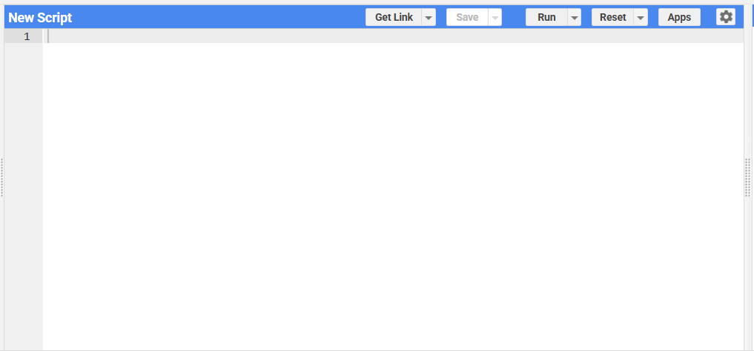
Create Script
Scripts are written in the central pane of the Code Editor. The primary language is JavaScript, though Python APIs can also be used
Useful Google Earth Engine Shortcuts
Ctrl + Enter: Run the script
Ctrl + /: Comment or uncomment selected lines
Ctrl + S: Save the script
Ctrl + Z: Undo
Ctrl + F: Find text in the script
Ctrl + H: Find and replace
Ctrl + A: Select all code
Esc: Close pop-ups or cancel actions
Once scripts are written in the code editor, click the Run button on the top taskbar to execute them. You can then save the script using the Save button for future use or modification.
Add assets to your script by clicking the arrow ( > ) next to the asset name in the Assets panel. This inserts a reference variable you can use in your code.

Slide 44
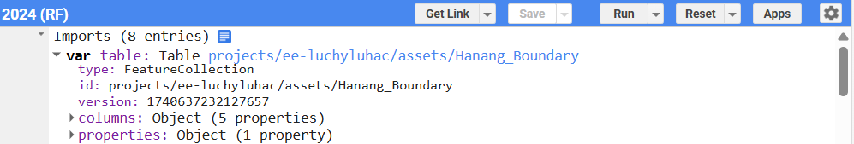
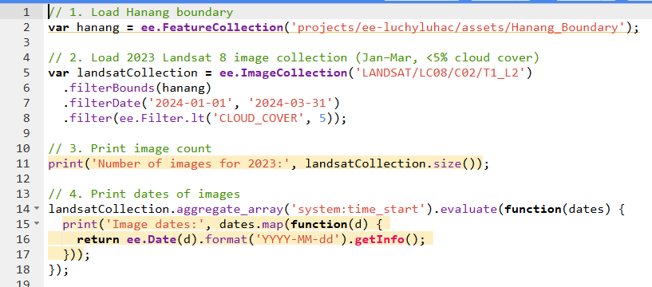
Script
Step 1
involves recalling the asset path. You can find it in the metadata by clicking the dropdown arrow ( > ) next to the asset imported.
Step 2
Loads the image. This stage involves:
Choosing the sensor (e.g. Landsat, MODIS, Sentinel).
Clipping the image to your selected boundary.
Selecting the date range to filter the imagery.
Setting the maximum cloud cover threshold to filter cloudy images.
Step 3 & 4
are optional but good practice. They help confirm that images exist under the selected criteria by:
Printing the number of images found
Listing the dates the images were captured.

Slide 45
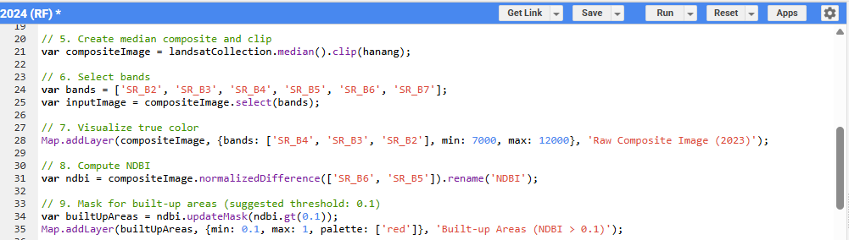
Script cont
Step 6
Chooses specific spectral bands relevant to your analysis. Its advised to choose all bands as you may need to use the code for more applications in the future
Step 5
Generates a single image by computing the median of all images in the filtered collection (selecting the best image per pixel (in cloud cover terms). Then, clip this composite to your shape file.
Step 7
Display a true color image by assigning Red (SR_B4), Green (SR_B3), and Blue (SR_B2) bands. This helps visually inspect the landscape. It could involve different combinations for different sensors.
Step 8 & 9
Calculates the Normalized Difference Built-up Index (NDBI) and masks the high values for visualization (above 0.1). It helps classifying by identifying buildings on images that they cannot be seen clearly.

Slide 46
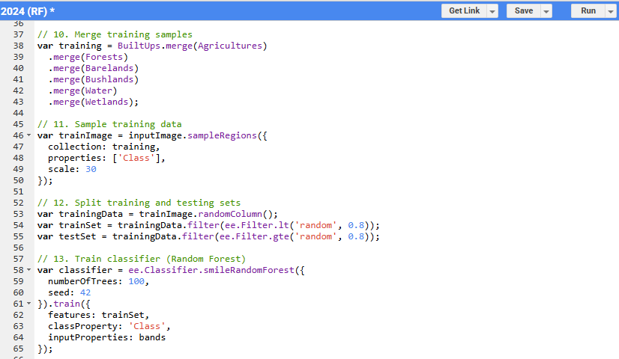
Script cont
Step 11
extracts pixel values from the input image at the training sample locations. These values are labeled by class and used to train the classifier.
Step 10
involves merging the classes you intend to use for classification. These names should be noted since the same ones will be used to create training samples
Step 13
Trains a Random Forest classifier using the training set. This machine learning model uses multiple decision trees to classify land cover types based on the selected input bands.
Step 12
Randomly splits the labeled data into a training set and a testing set. This helps check the accuracy of the classifier before applying it to the whole image.

Slide 47
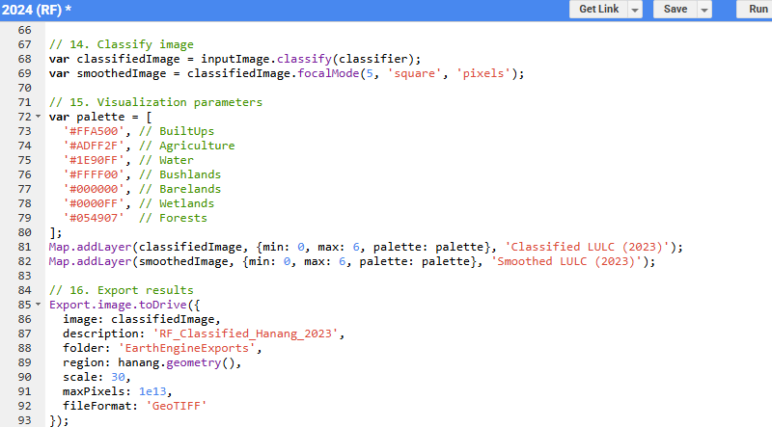
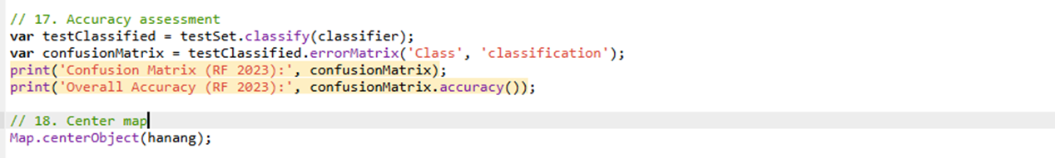
Script cont
Step 16
exports the classified image to Google Drive as a GeoTIFF, specifying the export name, target folder, area (region), spatial resolution (scale), pixel limit, and file format.
Step 14
classifies the image and also provides a smoother classified image using matrixes to assign each pixel the most frequent class within its neighborhood.
Step 17
assesses the accuracy of the classification performed. Classifications with accuracies lower than 85% should increase training data.
Step 15
This section defines a color palette for each land cover class and visualizes both the raw and smoothed classified images on the map.
Step 18
zooms the map interface to your area of interest

Slide 48
LAND COVER MAPPING
Step 01 📍Upload Shapefile / Insert Coordinates Step 02 👨‍💻 Create Script
Step 03
Training Data
Step 04 📤 Export and ⬇️ Download Result

Slide 49
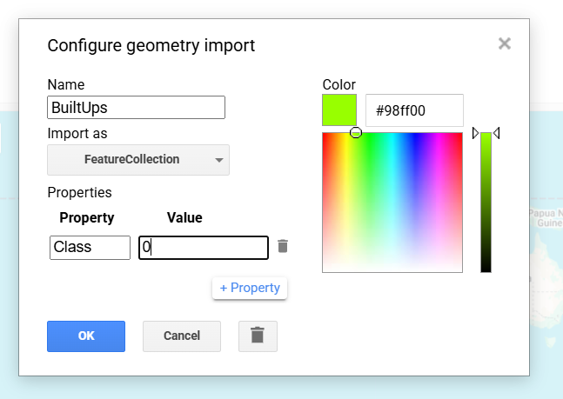
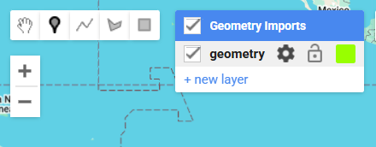


Training Data
Import as a feature collection. This allows collection of multiple points under the same class
Now we are going to use the map layout (below the coding area) to train our data
Select the point marker icon to activate the point geometry feature.
Name- make sure you use the same class names as you did in the code (avoid spelling mistakes)
The property is class and the value will be unique for every class, starting from 0 in chronological order
Next select the gear icon to activate the point geometry feature.
Pick a color for the marker of that particular class

Slide 50
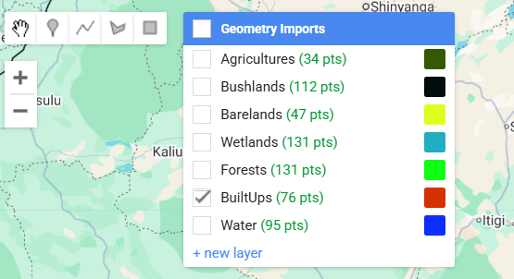
Training Data
Next, once all the classes are defined. Run the code. An error* will occur but worry not, this error happens because there isn’t any class that’s been trained yet. We do however need to run the code to visualize the image to be used for training
*Errors are found in the console tab which is on the right pane
In the Geometry tab, all defined classes will be listed. By clicking on a class and then selecting the point marker icon, you can select locations that appear to be part of that class. The more points the better trained the algorithm is.

Slide 51
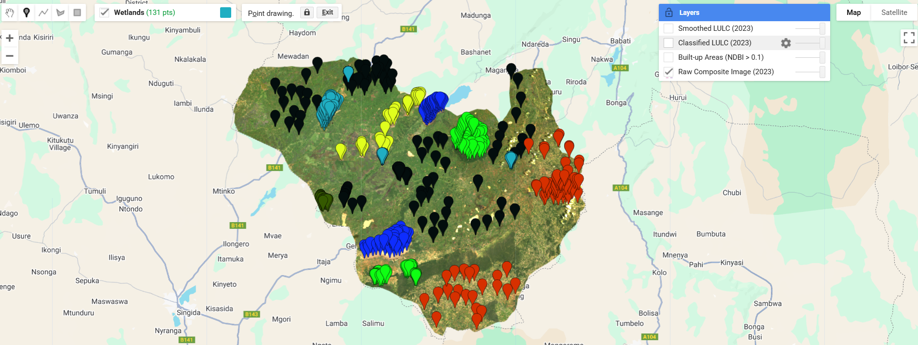
Training Data

Slide 52
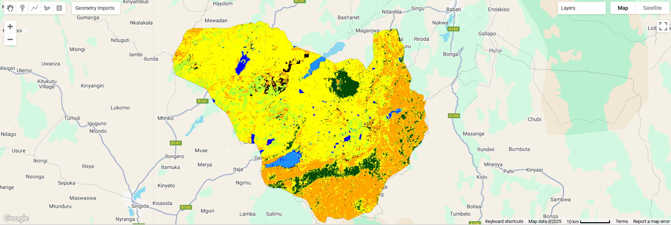
RESULT
Run the code again after selecting points for each class. The error should be gone and the classified image should be displayed

Slide 53
LAND COVER MAPPING
Step 01 📍Upload Shapefile / Insert Coordinates Step 02 👨‍💻 Create Script
Step 03
Training Data
Step 04 📤 Export and ⬇️ Download Result

Slide 54
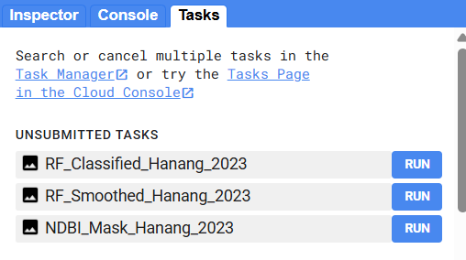
Export and Download Results
From the tasks tab found on the right pane, the tasks in the export function will be listed. Run the ones you need to export.
Once you run the task you can rename the layer and determine the destination folder
The files will then go to your google drive ready for use outside the platform

